Slide 1
Installing and using Python
Data Dawgs Presentation
By Jonathan Waring

Slide 2
Installing Anaconda
Anaconda is an incredibly popular Python distribution platform. It's the product of Continuum Analytics, and is effectively the de factoway to interact with the Python ecosystem at this point.
Translation: Use Anaconda for installing Python. DO NOT USE python.org unless you are super comfortable with micromanaging your Python install and the packages you download
Installing Anaconda is pretty easy: https://www.anaconda.com/download/

Slide 3
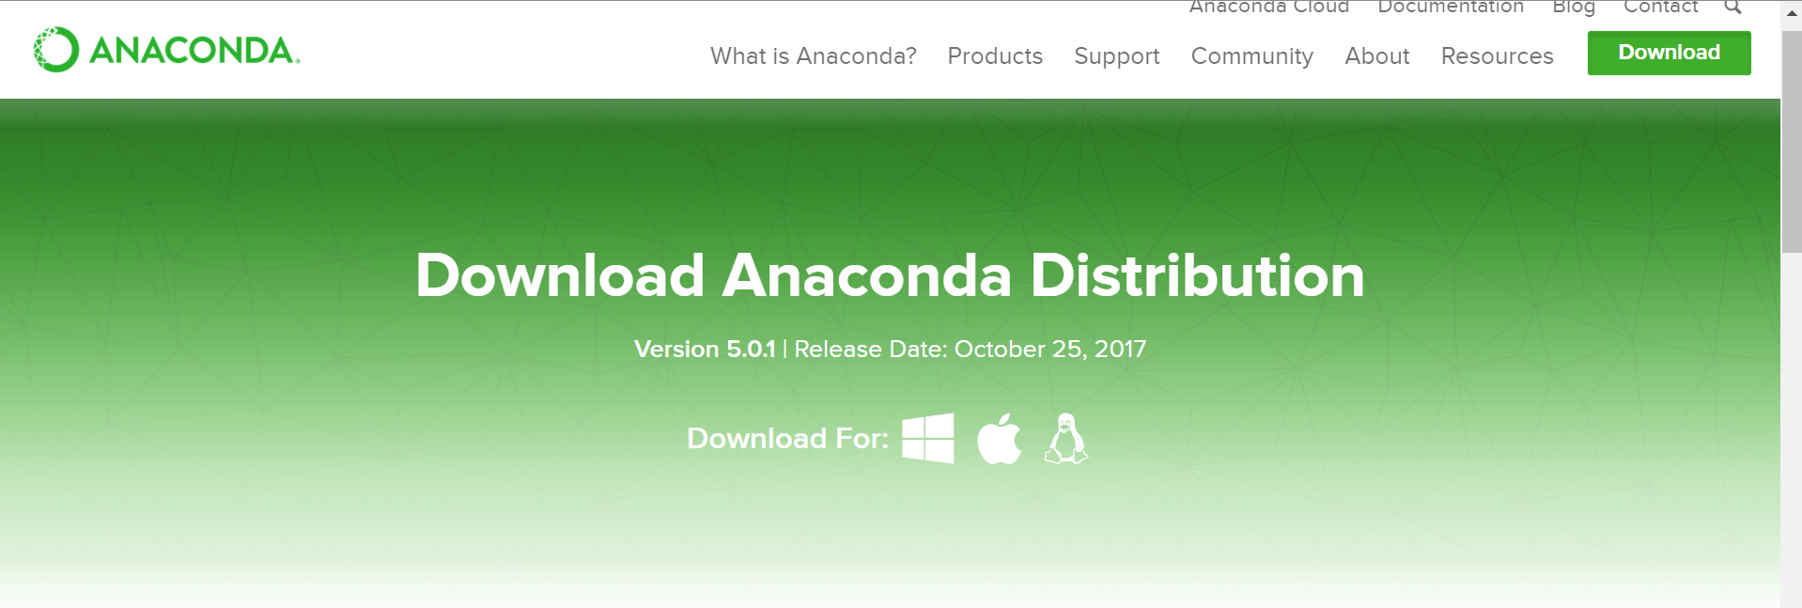
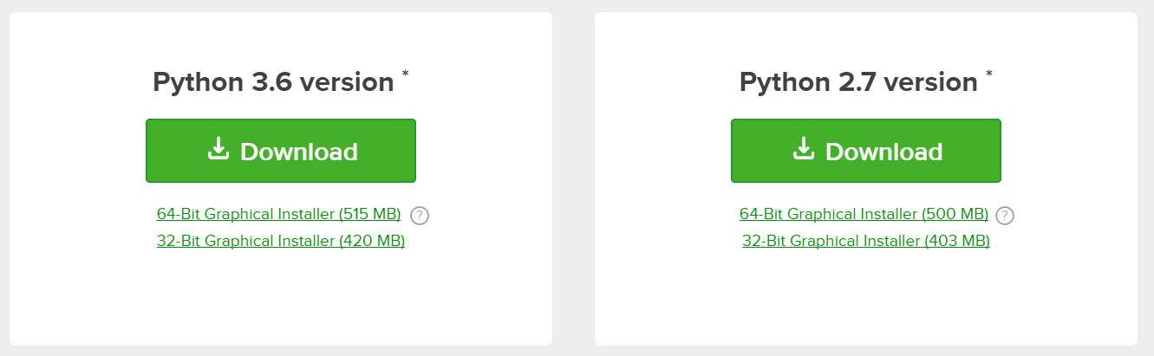
Click on the appropriate Operating System that you are using
Download Python 3.6

Slide 4
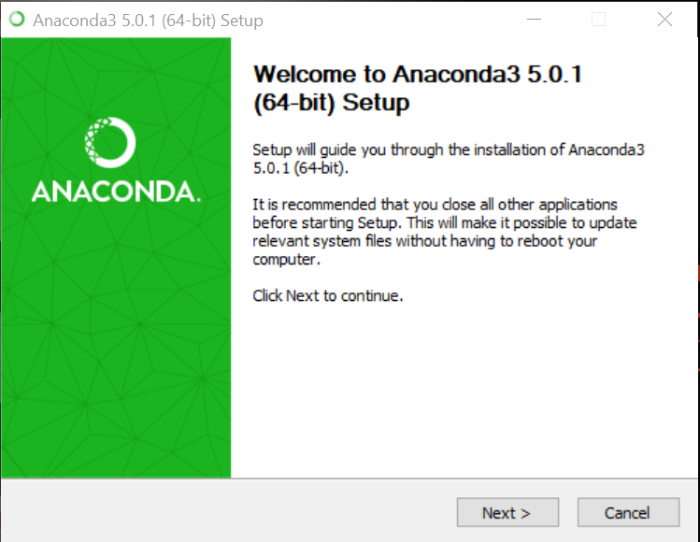
Installing Anaconda
Once the Anaconda3-*.exe file is done downloading, open it up to start the installer
Hit the next button, and agree to the license on the next page

Slide 5
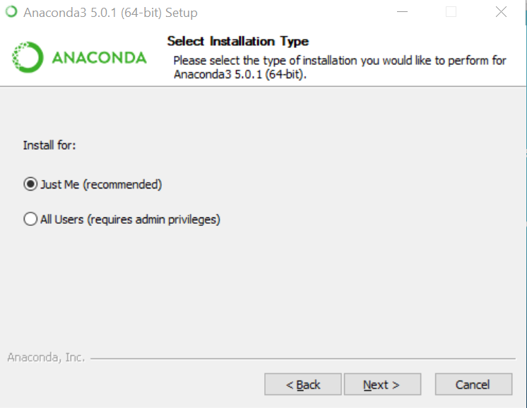
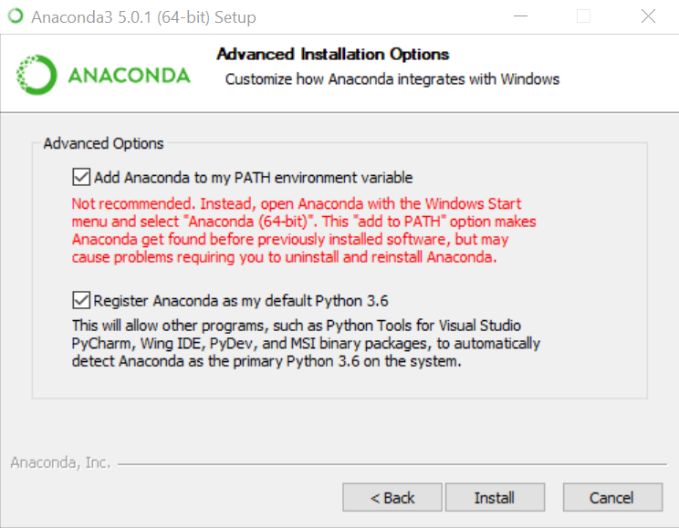
Anaconda Download setting

Slide 6
Anaconda Navigator
Once the download is complete, search for “Anaconda Navigator” on your computer and open it up
We’ll explain more about what’s in there

